Slide 1
INFO6105: DATA SCIENCE ENGINEERING METHODS FINAL PROJECT
STOCK MARKET PREDICTION
Name : Dhanush Nandish
NUID: 002205433

Slide 2
aim- To build a machine learning model using regression algorithms to accuately predict the desired target variable (stock price).

Slide 3
Methods Utilised
In this project we have used Regression algorithms to train the machine learning models for prediction process.
The regression algorithms used are Linear Regression and Support Vector Machine Regression algorithm.
Using regression algorithms, parameters such as mean absolute error, mean squared error, maximum error, average positive mean square error, and coefficient of determination are computed for evaluation on training and testing data.

Slide 4
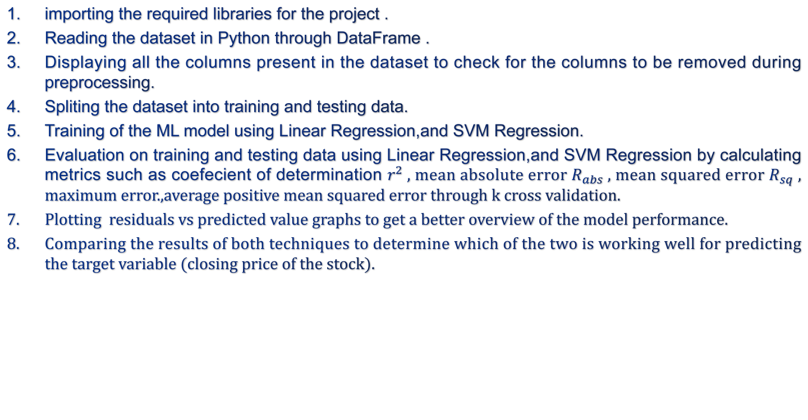
Steps followed
importing the required libraries for the project .
Reading the dataset in Python through DataFrame .
Displaying all the columns present in the dataset to check for the columns to be removed during preprocessing.
Spliting the dataset into training and testing data.
Training of the ML model using Linear Regression,and SVM Regression.
Evaluation on training and testing data using Linear Regression,and SVM Regression by calculating metrics such as coefecient of determination $r^{2}$, mean absolute error $R_{abs}$, mean squared error $R_{sq}$ , maximum error.,average positive mean squared error through k cross validation.
Plotting residuals vs predicted value graphs to get a better overview of the model performance.
Comparing the results of both techniques to determine which of the two is working well for predicting the target variable (closing price of the stock).

Slide 5
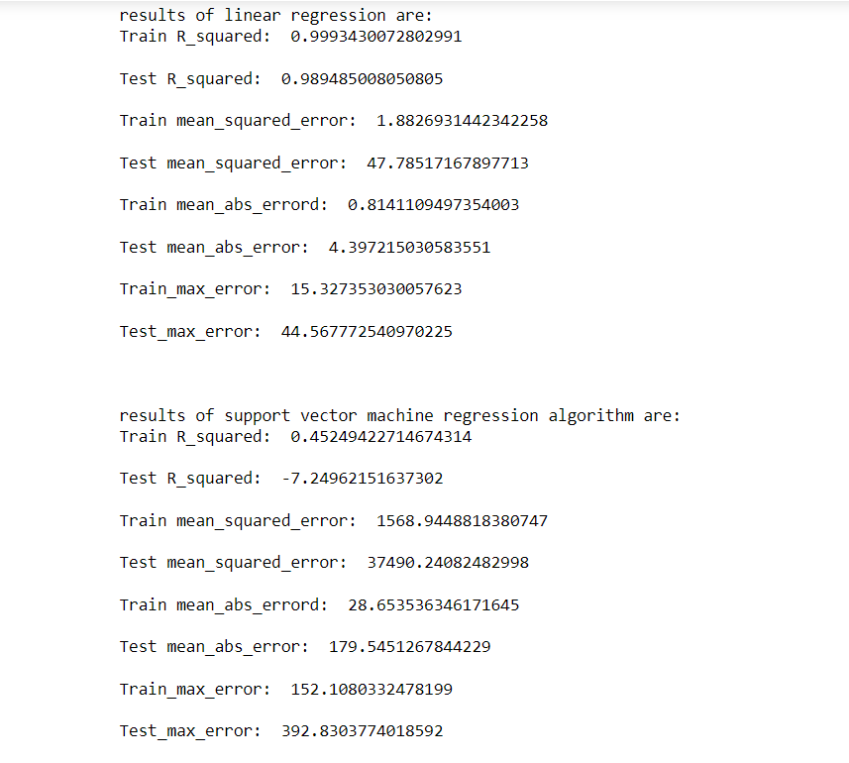
Results

Slide 6
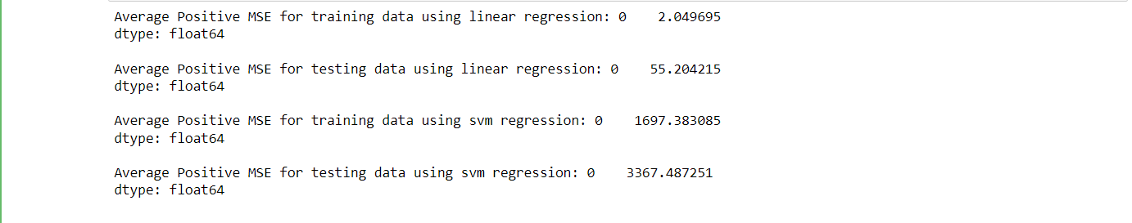
Results
Average positive mean squared error obtained using K cross validation

Slide 7
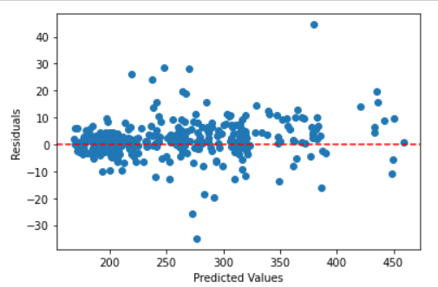
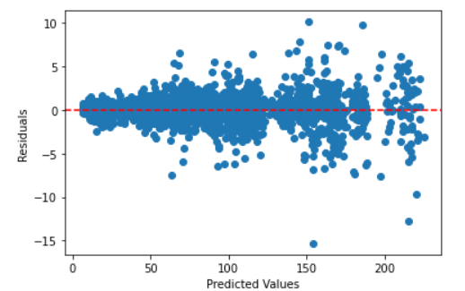
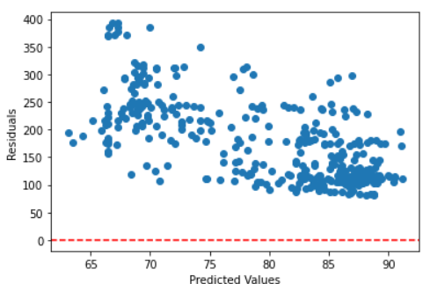
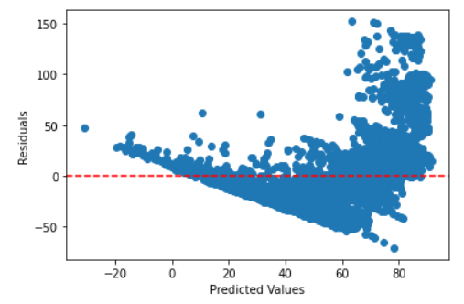
Results
residuals vs predicted data for testing data using linear regression residuals vs predicted data for training data using linear regression
residuals vs predicted data for testing data using svm regression residuals vs predicted data for training data using svm regression

Slide 8
Conclusion
Linear regression is working well on our model to predict the closing price of the stock compared to SVM regression; this can be stated by not only observing the coefficient of determination but also the errors computed.
We can also observe the residuals vs. predicted data plot. The residuals for training and testing data are scattered around zero for linear regression.
Whereas for SVM regression, the residuals are very high and scattered away from zero.

Slide 9
References
Dataset URL:
https://www.kaggle.com/datasets/nikhilkohli/us-stock-market-data-60-extracted-features/data

